Slide 1


A-Ware
(Automatic Warehouse)
#Your warehouse solutions

Slide 2

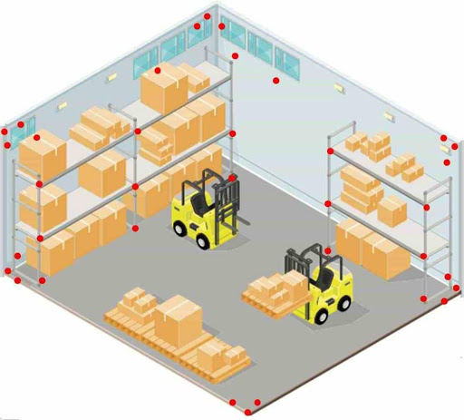
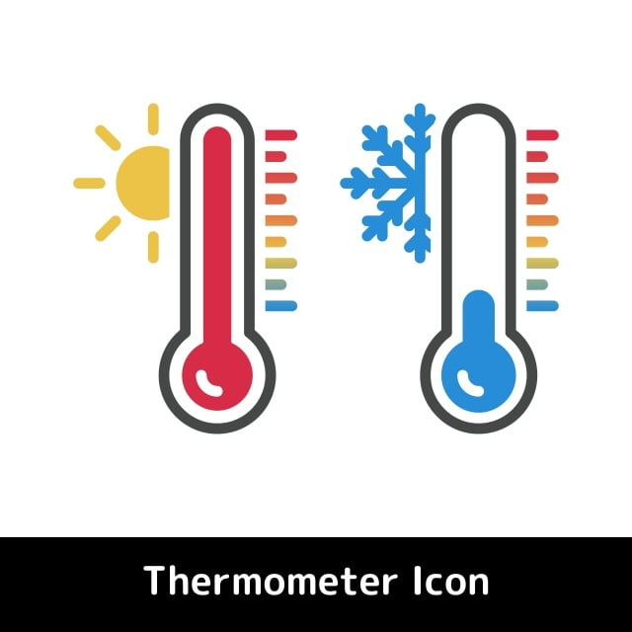
PROBLEM
Complicated and cumbersome inventory recording
Disorganized inventory management
Monitoring room temperature and humidity is not done in real time

Slide 3

SOLUTION
A website platform where used to optimize the warehouse, that are:
ORDERLY
AND
EFFICIENT
RECORDING INVENTORY
MONITORING
easily and practically
when managing inventory
room temperature & humidity in real-time

Slide 4
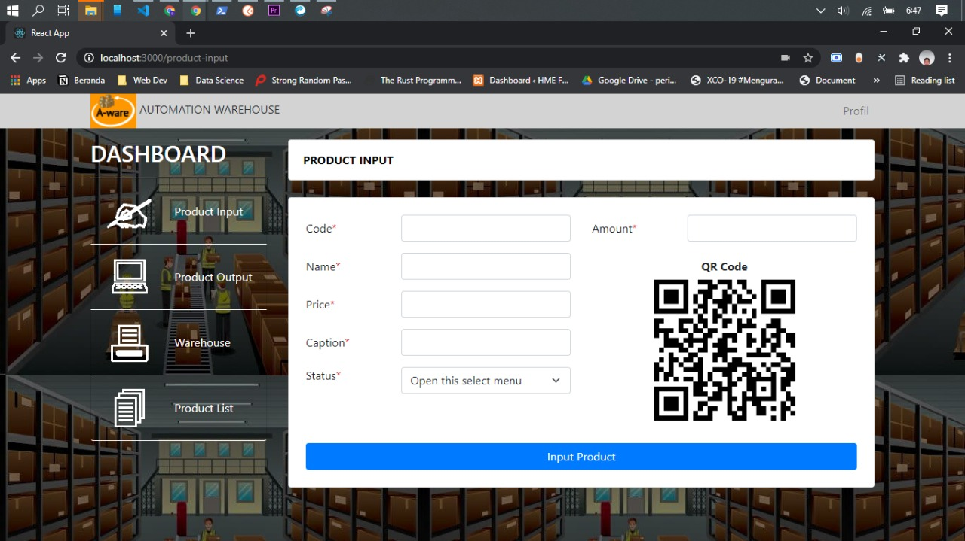
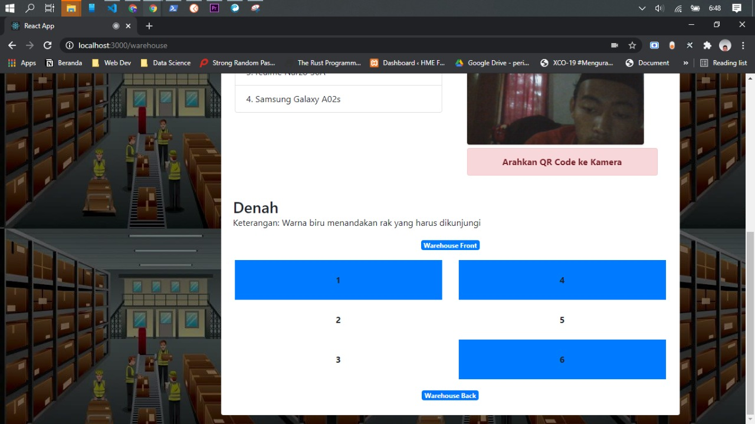
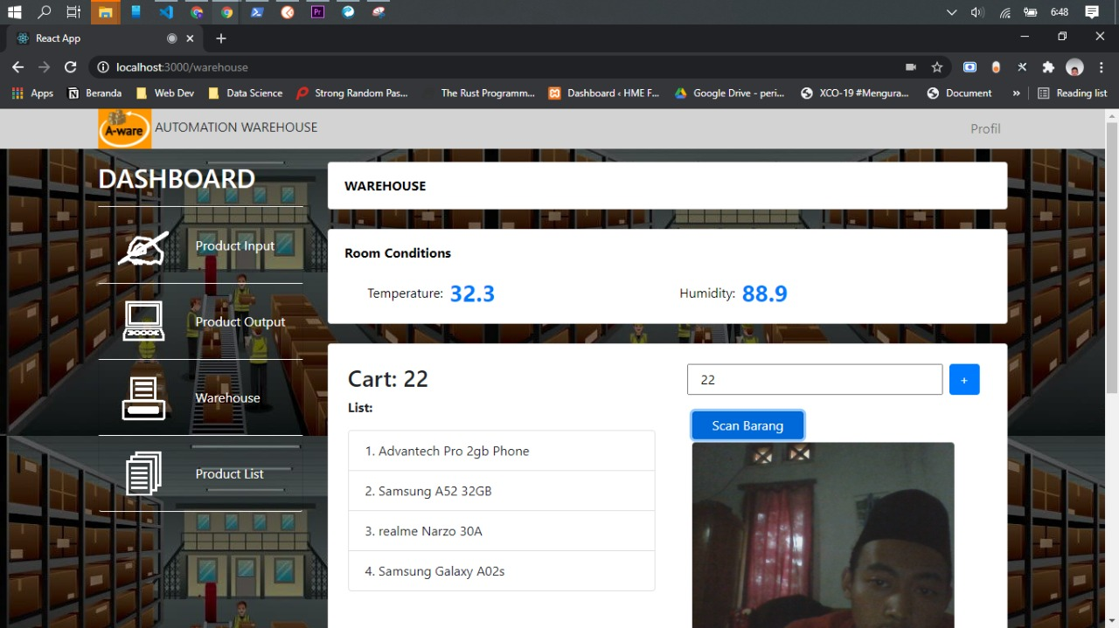
PRODUCT OVERVIEW
Record inventory
Manage inventory
Monitoring room
temperature & humidity

Slide 5







ARCHITECTURE
AWS Document DB
User
Website
A-Ware
AWS
Amplify
AWS API
Gateway
AWS Lambda
Merchant

Slide 6
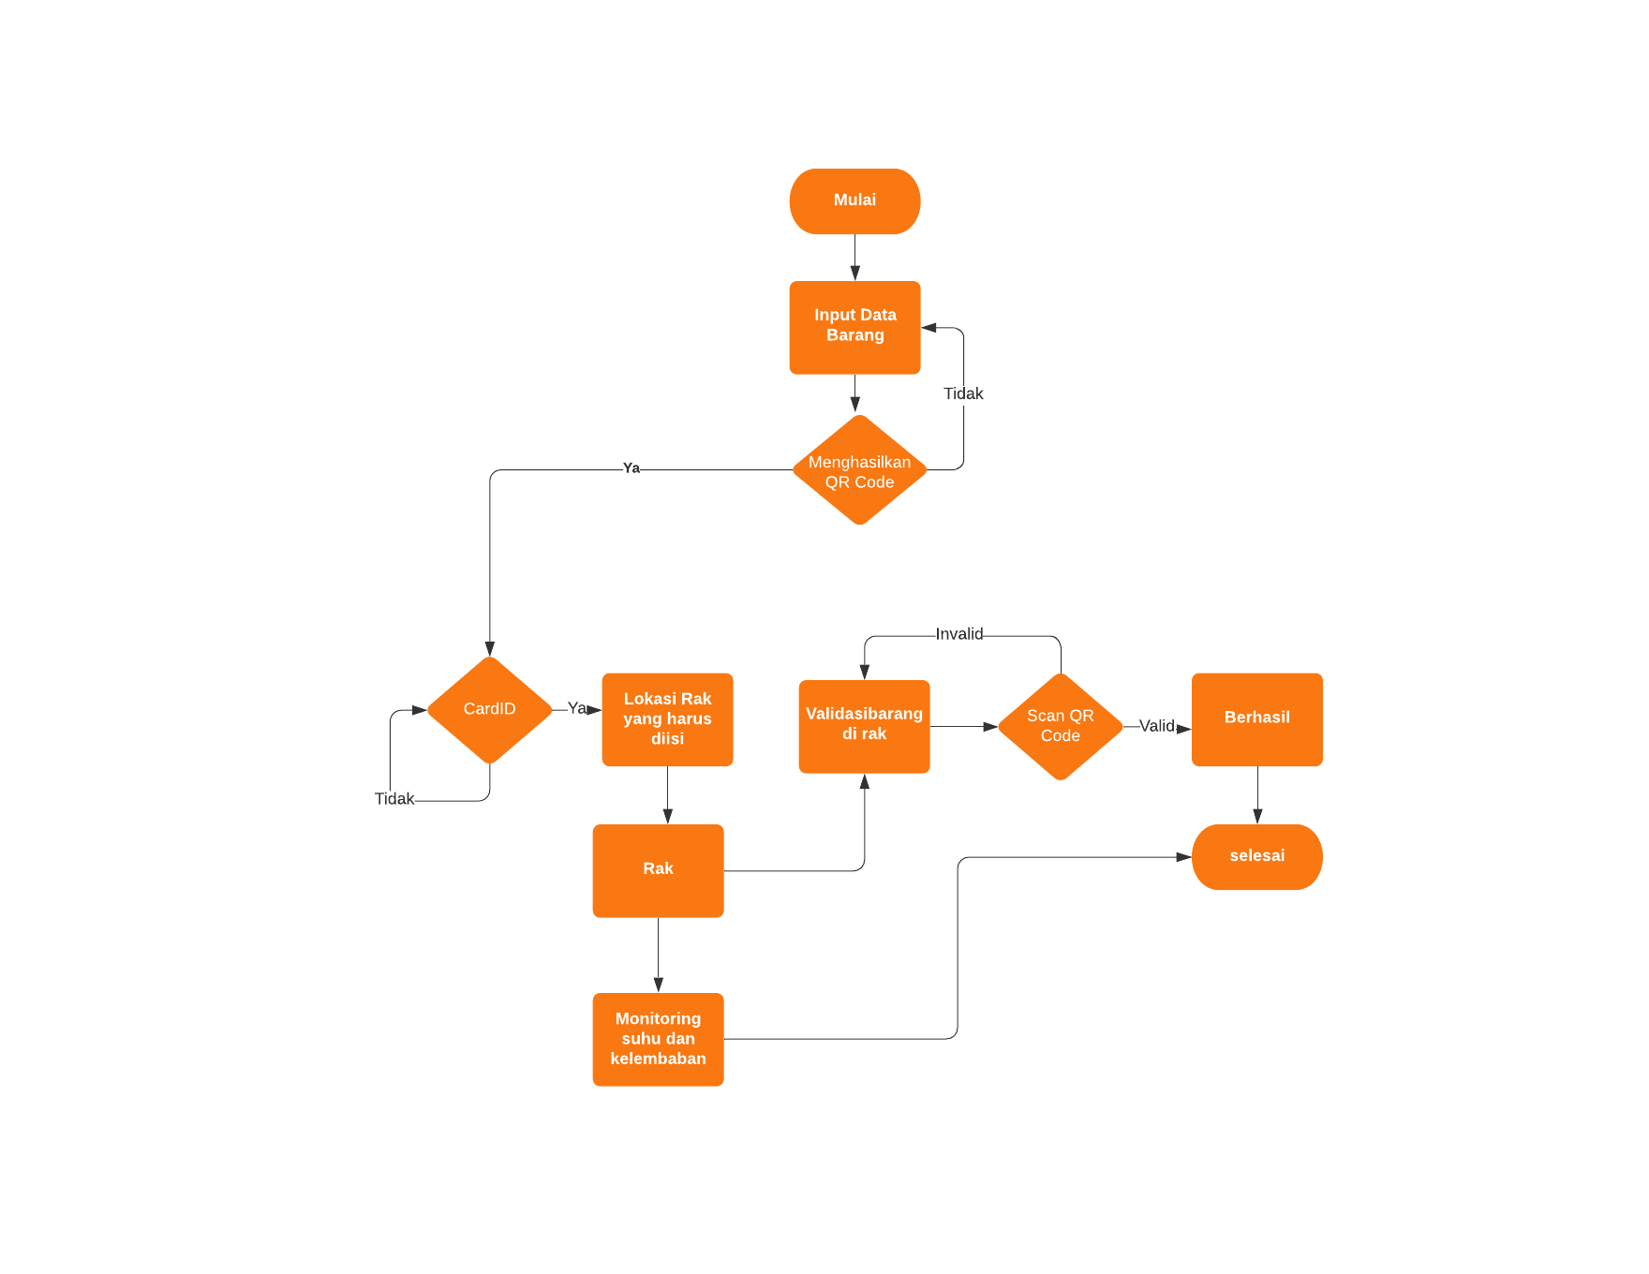
SYSTEM WORKFLOW

Slide 7
MARKET SIZE
Total Addressable Market
Serviceable Addressable Market
IDR 197,393 B
Serviceable Obtainable Market
$ 220.9 B
$ 19.66 B
From 270 M Population in Indonesia and logistic market is expected to get a noteworthy CAGR of 7.9% / year
From 24 M (8.9%) population in Indonesia who have used smart warehouse services
$ 1.96 B

Slide 8
BUSINESS MODEL
We take $ 14 for selling A-Ware devices
Share of Market
Fee
Revenue
2.400.000
$ 14
$ 33.6 M

Slide 9
FUTURE PLAN
A-ware
Take part in a smart city that focuses on smart logistics
One-step warehouse optimization solution in the logistics sector
Startups engaged in the logistics sector
Development phase
to the beta stage

Slide 10

DEMO PRODUCT
https://drive.google.com/file/d/1ydVCUA-ojrcnfVqLqKQXhvqeBb5O56NW/view?usp=sharing

Slide 11

Regards, A-Ware #Your warehouse solutions

